Slide 1
2.12/2.120 Introduction to Robotics
February 23-24, 2023
Lab 3: DC Motor Control

Slide 2
Objectives
Understand the Proportional, Integral, and Derivative (PID) control actions.
Derive closed-loop transfer functions.
Design and fine-tune a PI controller for velocity control.
Design and fine-tune a PD controller for position control.
Term Project: Task strategy.

Slide 3
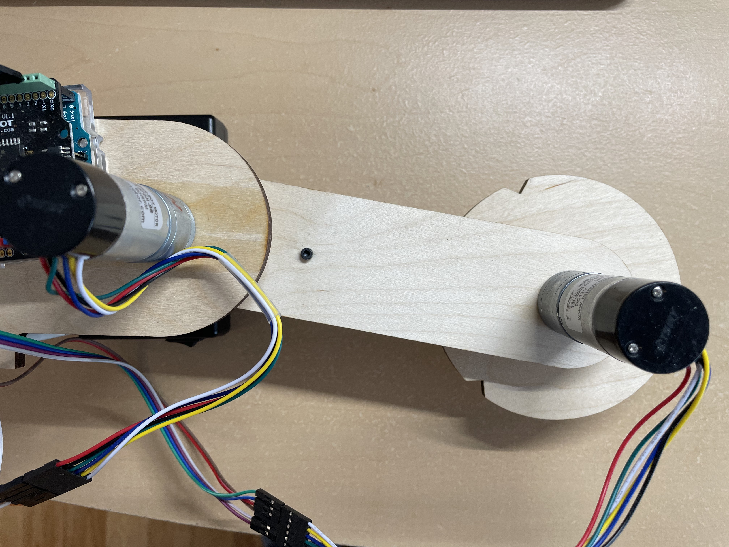
System Setup
Detach the second link and attach the disc to Motor 2.
Motor 1
Disk
Motor 2

Slide 4
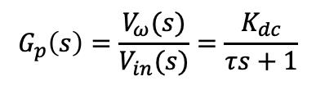
1st Order Open Loop Step Response
$$G_{p}\left(s\right)=\frac{V_{ω}(s)}{V_{in}(s)}=\frac{K_{dc}}{τs+1}$$
63%
DC gain
τ (sec)

Slide 5
Standard Closed-Loop PID Control
G(s)
+
Controller
Plant
G_{c}(s)
G_{p}(s)
_
H(s)
PID controller transfer function
PID controller pseudo code

Slide 6
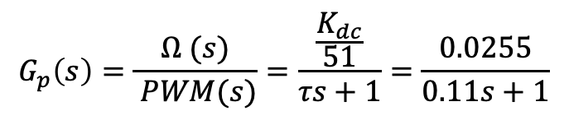
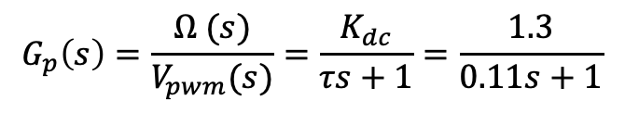
Estimate Open-Loop Transfer Function
Plant transfer function:
$$G_{p}\left(s\right)=\frac{Ω (s)}{V_{pwm}(s)}=\frac{K_{dc}}{τs+1}=\frac{1.3}{0.11s+1}$$
PWM = 255 corresponds to 5V from PWM pin (1V = 51 PWM) so we can further represent the transfer function as:
$$G_{p}\left(s\right)=\frac{Ω (s)}{ PWM(s)}=\frac{\frac{K_{dc}}{51}}{τs+1}=\frac{0.0255}{0.11s+1}$$

Slide 7
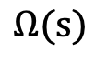
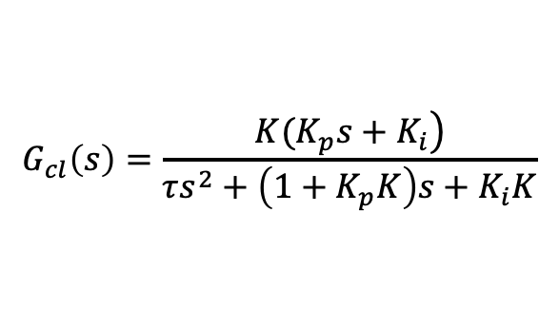
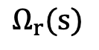
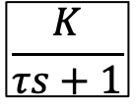
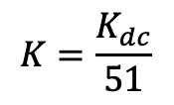
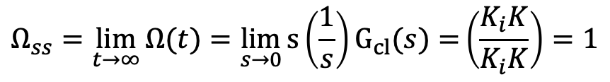
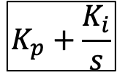
Velocity Control with P&I Control Actions
$$K=\frac{K_{dc}}{51}$$
Controller
Velocity Plant
$$Ω_{r}(s)$$
_
$$K_{p}+\frac{K_{i}}{s}$$
$$\frac{K}{τs+1}$$
$$Ω(s)$$
+
$$G_{cl}\left(s\right)=\frac{\left.K(K_{p}s+K_{i}\right)}{τs^{2}+\left(1+K_{p}K\right)s+K_{i}K}$$
One zero
Closed-Loop Transfer Function:
Two poles
$$Ω_{ss}=\lim_{t→∞}{Ω(t)=\lim_{s→0}{s\left(\frac{1}{s}\right)G_{cl}(s)=}}\left(\frac{K_{i}K}{K_{i}K}\right)=1$$
Steady-state
No steady-state error with a step input

Slide 8
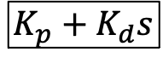
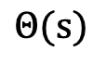
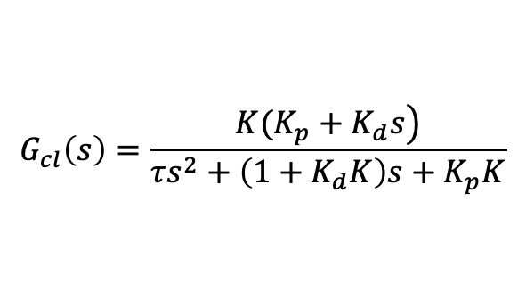
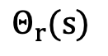
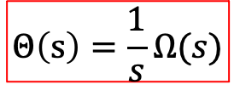
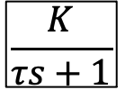
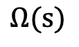
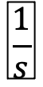
Position Control with P&D Control Actions
Plant
Controller
$$\frac{K}{τs+1}$$
$$Ω(s)$$
$$\frac{1}{s}$$
$$Θ_{r}(s)$$
+
_
$$K_{p}+K_{d}s$$
$$Θ(s)$$
$$Θ\left(s\right)=\frac{1}{s}Ω(s)$$
$$G_{cl}\left(s\right)=\frac{\left.K(K_{p}+K_{d}s\right)}{τs^{2}+\left(1+K_{d}K\right)s+K_{p}K}$$
One zero
Closed-Loop Transfer Function:
Two poles
A “free” integrator
No steady-state error with a step input

Slide 9
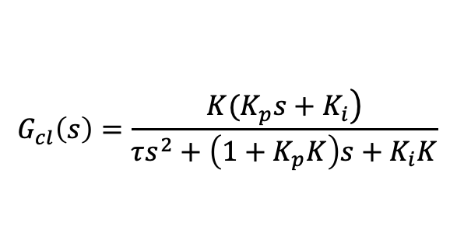
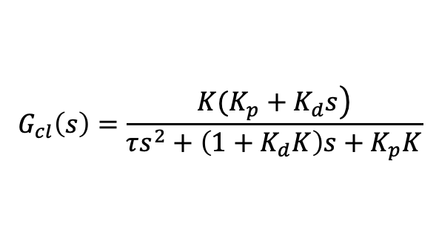
Comparison of Closed-Loop Transfer Functions
$$G_{cl}\left(s\right)=\frac{\left.K(K_{p}s+K_{i}\right)}{τs^{2}+\left(1+K_{p}K\right)s+K_{i}K}$$
PI Control of Velocity:
PD Control of Position:
$$G_{cl}\left(s\right)=\frac{\left.K(K_{p}+K_{d}s\right)}{τs^{2}+\left(1+K_{d}K\right)s+K_{p}K}$$

Slide 10
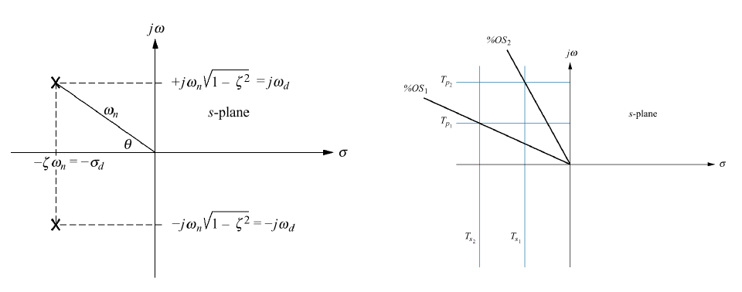
2nd Order System Poles
(within 2%)

Slide 11
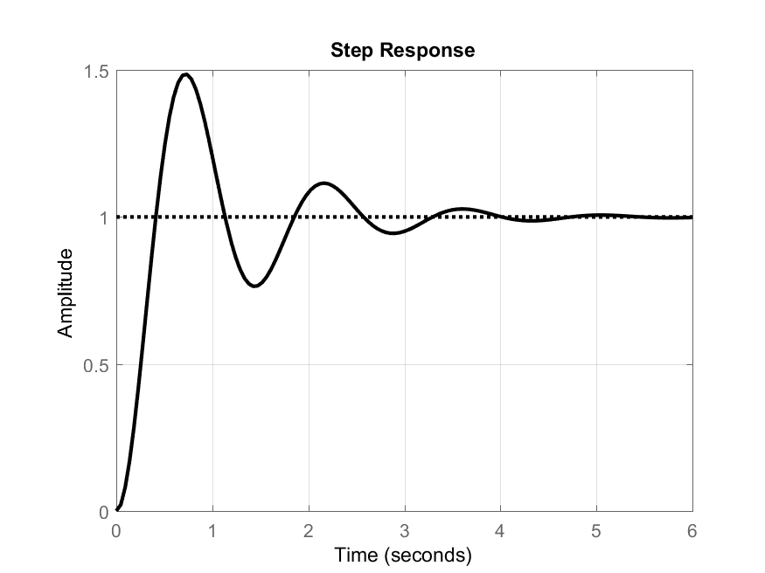
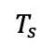
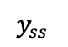
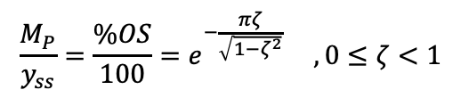

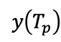
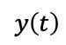
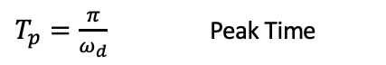
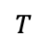
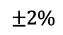
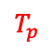
Dynamic Response Characteristics
$$y\left(T_{p}\right)$$
$$T_{s}≈\frac{4}{σ}=\frac{4}{ζω_{n}}$$
2% Settling Time
$$T$$
$$M_{p}$$
$$±2\%$$
$$T_{s}≈\frac{4.6}{σ}=\frac{4.6}{ζω_{n}}$$
1% Settling Time
$$y_{ss}$$
$$y\left(t\right)$$
$$ω_{d}=ω_{n}\sqrt{1−ζ^{2}}=\frac{2π}{T}$$
Damped Natural Frequency
$$T_{s}$$
$T_{p}=\frac{π}{ω_{d}}$ Peak Time
$$T_{p}$$
$$M_{P}≜y\left(T_{p}\right)−y_{ss}$$
Overshoot (Magnitude)
Example: Figure 1
$$y_{ss}=1$$
$$y\left(T_{P}\right)=1.5$$
$$\%OS≜\frac{y\left(T_{p}\right)−y_{ss}}{y_{ss }} ×100$$
Overshoot (Percent)
$$M_{P}=0.5$$
$$\%OS=50\%$$
$$ζ=−\frac{\ln{(0.5)}}{\sqrt{π^{2}+\ln^{2}\left(0.5\right)}}=0.215$$
$$\frac{M_{P}}{y_{ss}}=\frac{\%OS}{100}=e^{−\frac{πζ}{\sqrt{1−ζ^{2}}}} , 0≤ζ<1$$

Slide 12
Controller Design
Control action comparison:
Proportional – improves speed but with steady-state error in some cases
Integral – improves steady state error but with less stability; may create overshoot, longer transient, or integrator windup
Derivative – improves stability but sensitive to noise; may create large output when the input is not a continuous signal
Reduce overall gain can increase stability but with slower response
Avoid saturations
Set integrator limits to prevent windups

Slide 13
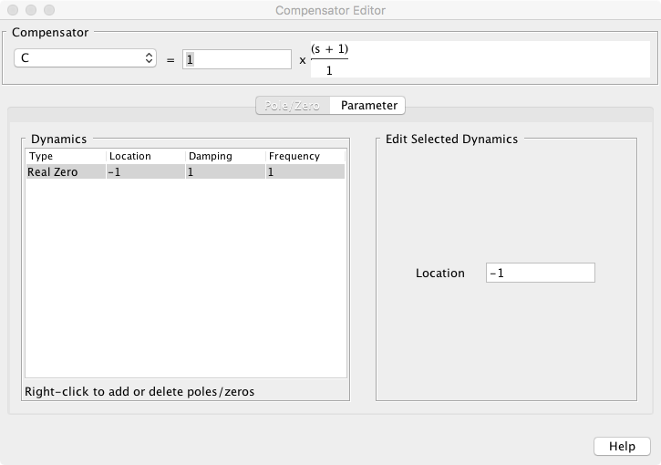
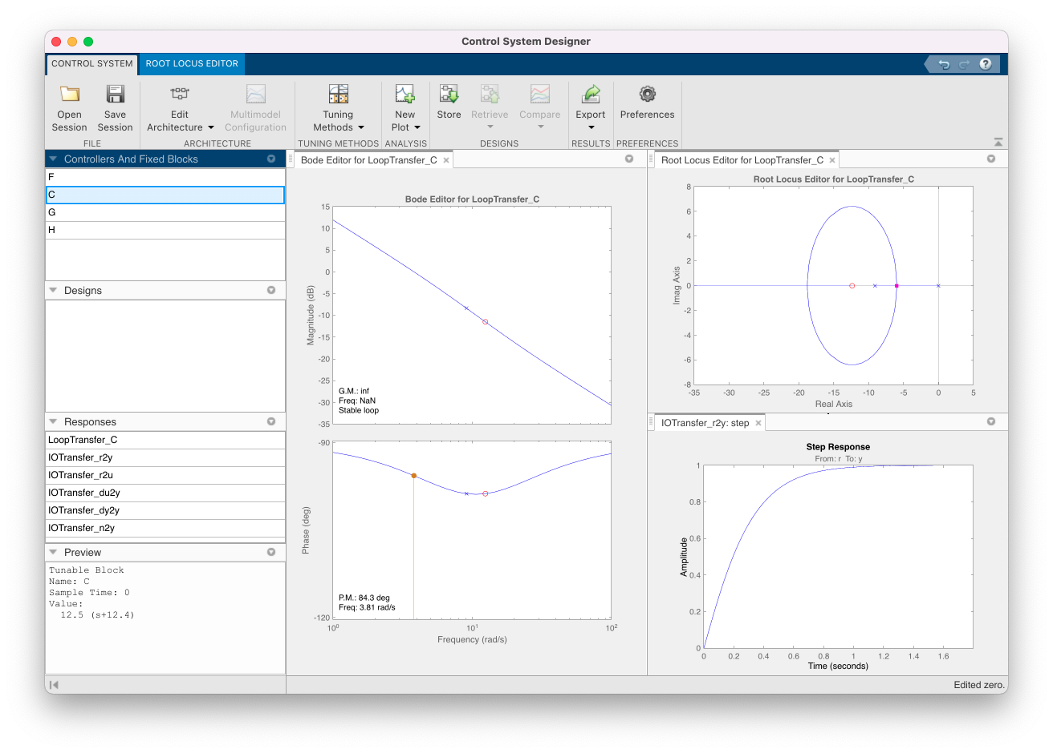
FYI: PD Controller Design with Matlab’s SISOTOOL
Design controllers with Matlab’s Control System Designer (aka. SISOTOOL)

Slide 14
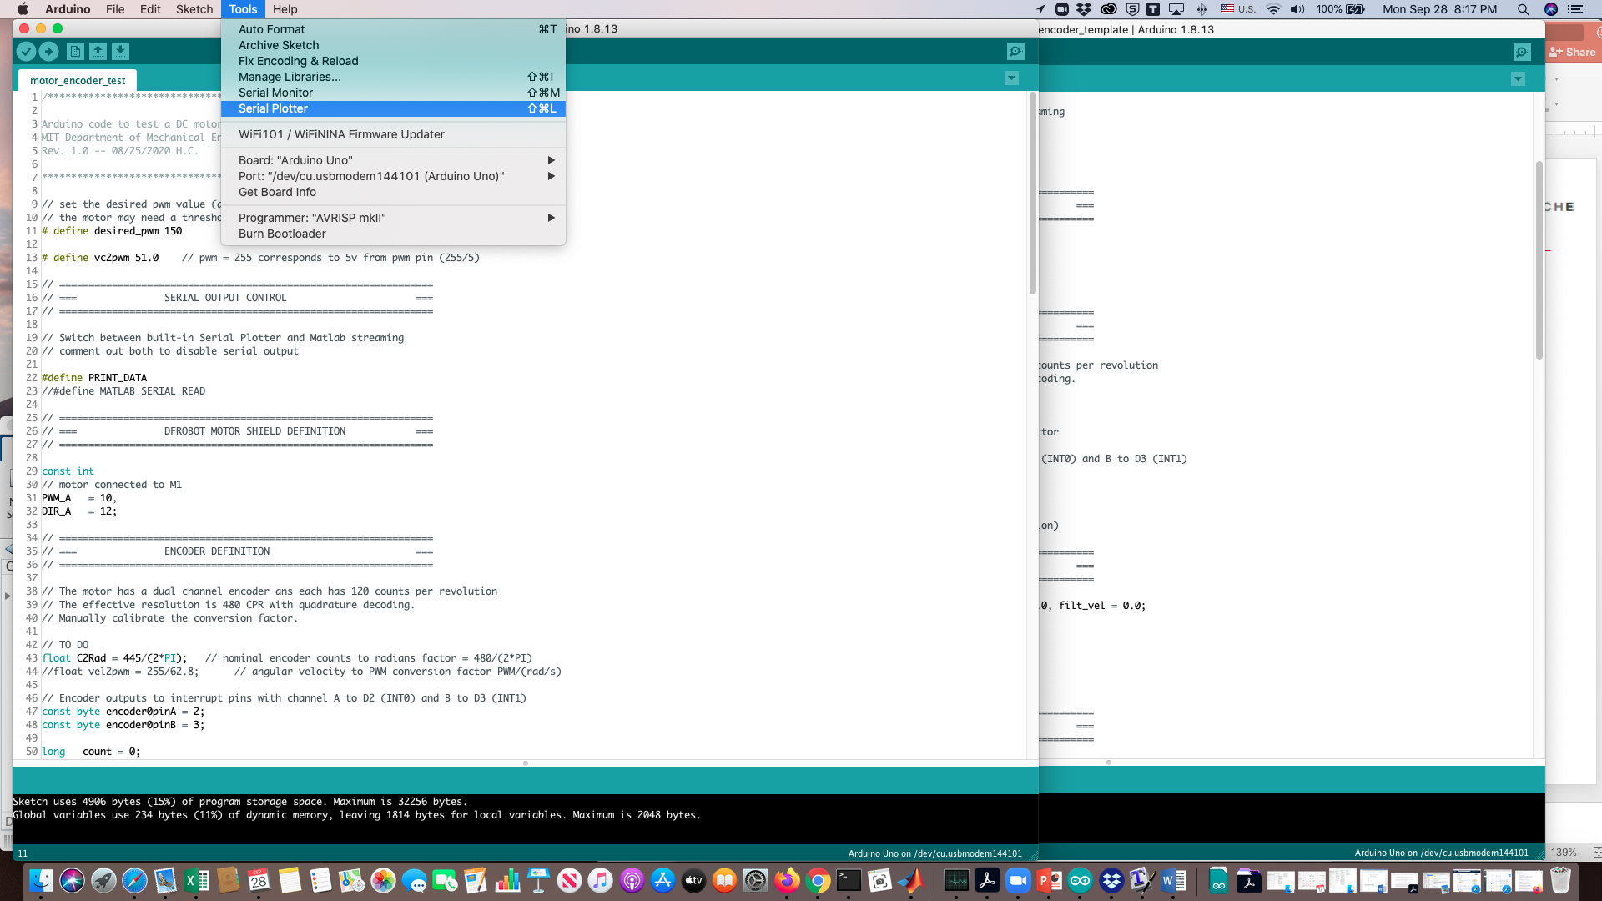
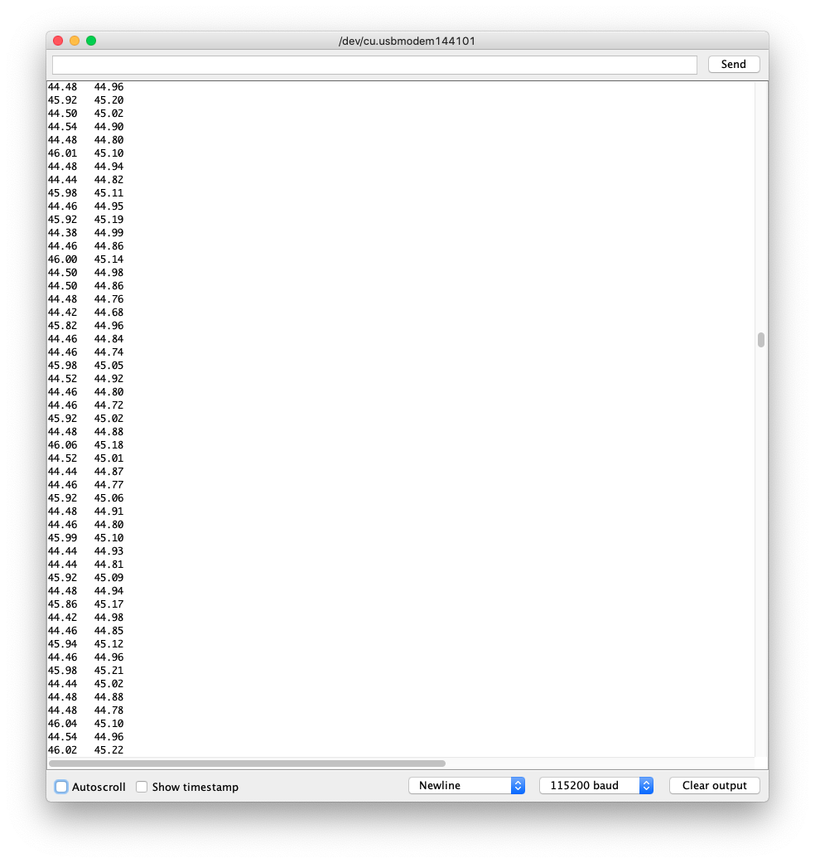
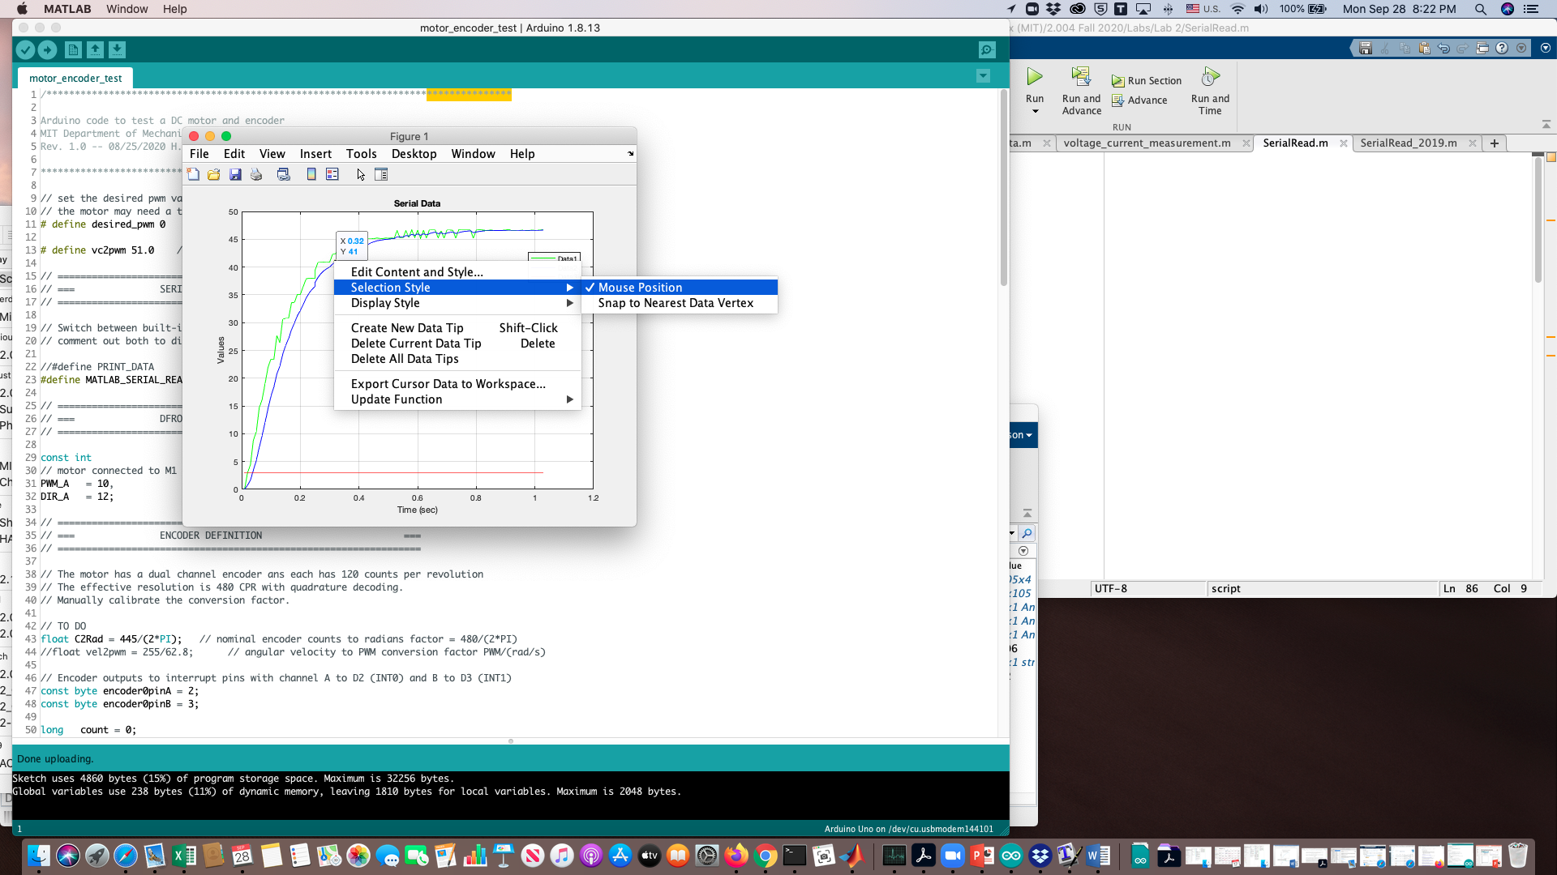
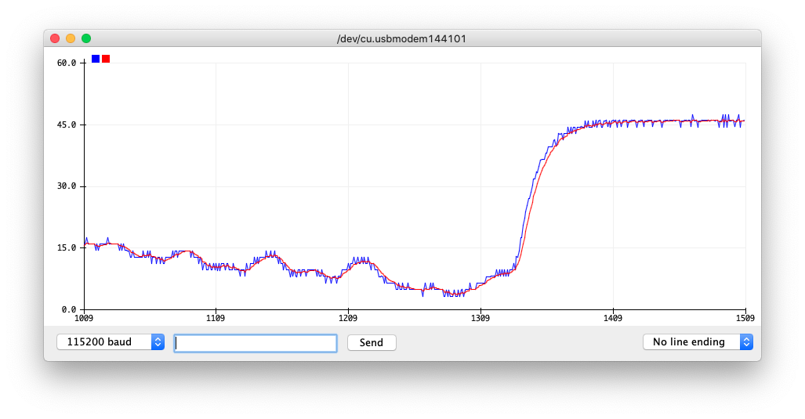
Monitoring/Capturing Serial Data
Serial Monitor is good for reading data values and to copy a portion of data record to clipboard.
Highlight a portion of data and copy and paste (may need to use keyboard shortcuts) to a variable in Matlab workspace, for example:
>> data =[paste data here];
Serial Plotter is useful for monitoring the transient behavior of data.
Uncheck “Autoscroll” to stop data streaming.
Neither “Serial Monitor” nor “Serial Plotter” is capable of saving data to a file.
The Matlab script “SerialRead.m” can be used to stream serial data directly into Matlab workspace for plotting and for post processing.

Slide 15
Code Files and Deliverable
Required code in GitHub: https://github.com/mit212/lab3_2023
Demonstrate to the lab staff your closed-loop responses.

Slide 16
Term Project: Task Strategy
Manipulator:
Design and fabricate an end-effector to perform CPR (Cardiopulmonary Resuscitation).
Detect and guide the end-effector to the chest of the patient.
May need computer vision and force feedback control.
Mobile Robot:
Design and fabricate a mechanism to get an AED (Automated External Defibrillator) bag.
Deliver the AED bag to the destination.
May need obstacle avoidance, path planning, and autonomous navigation.
Avatar:
Interact with the patient and the environment with VR headset and controllers.
Tele-operation of the manipulator.

Slide 17

DC Motor

Slide 18
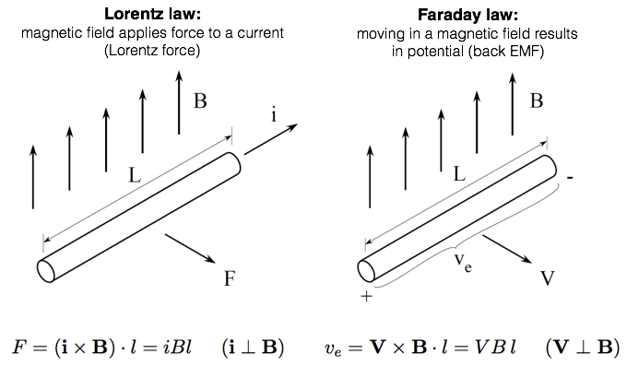
DC Motor Principle

Slide 19
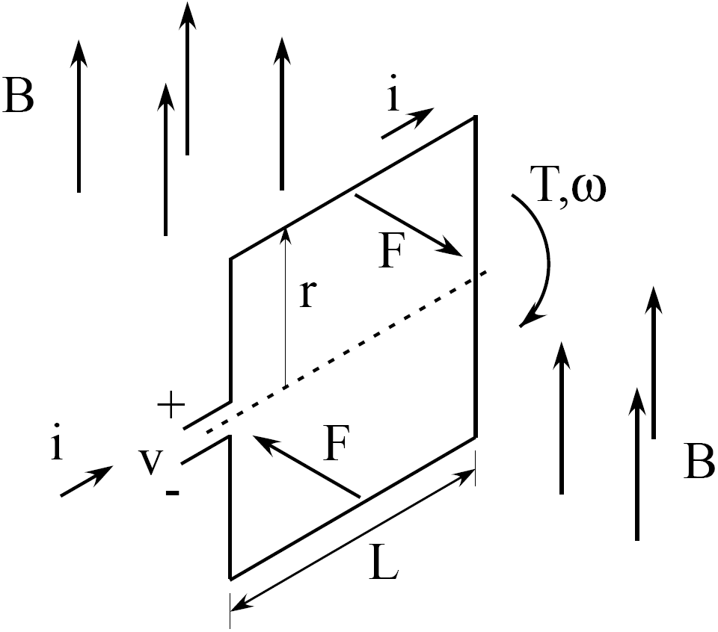
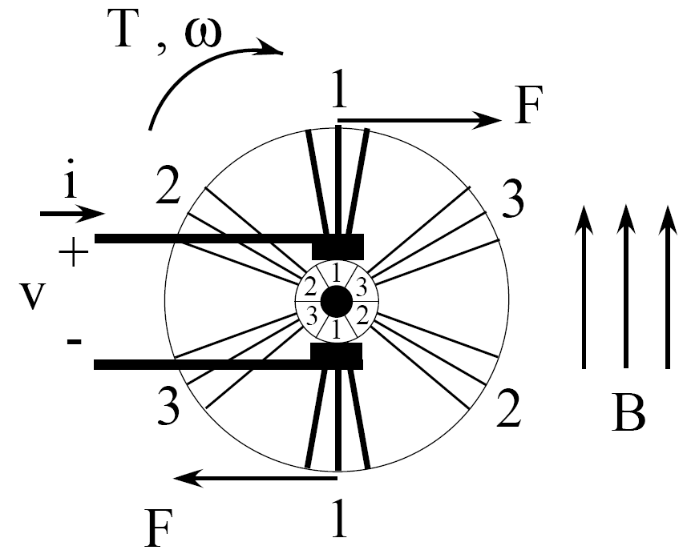
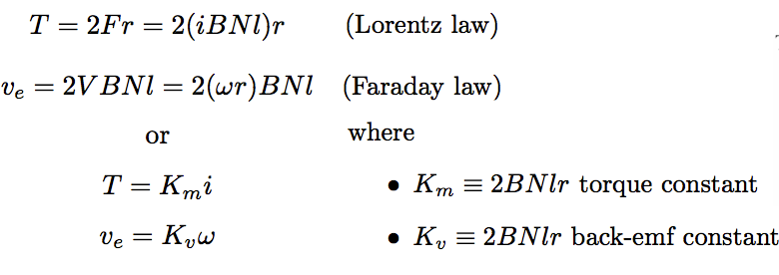

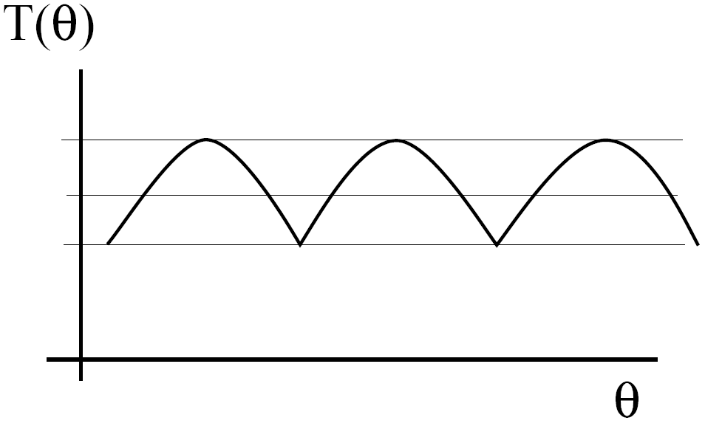

DC Motor Principle (Cont.)
multiple windings N:
continuity of torque

Slide 20
DC Motor as A Transducer
DC motor is an electromechanical system that may have a time constant close to the plant.
A transducer converts energy from one domain (e.g., electrical) to another (e.g., mechanical), or vice versa.

Slide 21
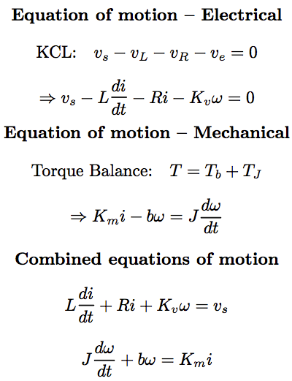
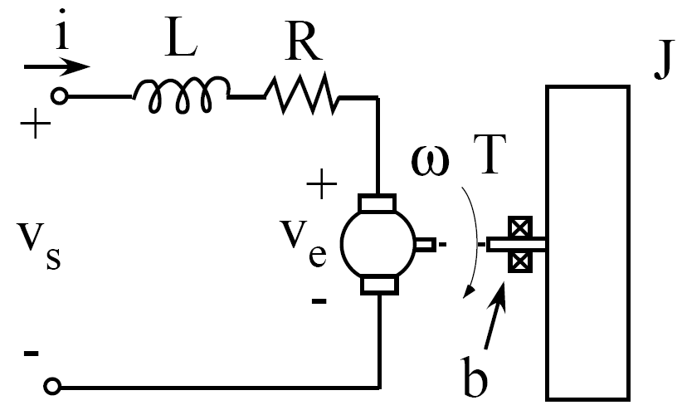
DC Motor with Mechanical Load
inductance
(due to windings)
dissipation
(resistance of windings)
KVL:
dissipation
(viscous friction
in motor bearings)
load
(inertia)

Slide 22
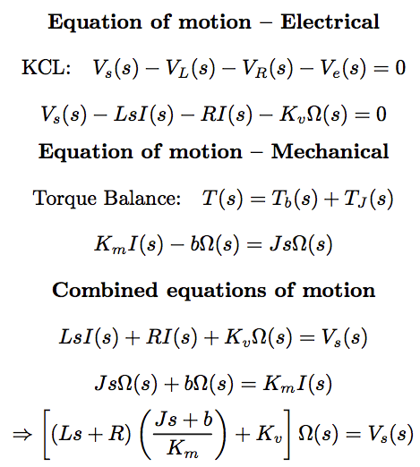

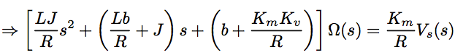
DC Motor with Mechanical Load
inductance
(due to windings)
dissipation
(resistance of windings)
KVL:
dissipation
(viscous friction
in motor bearings)
load
(inertia)

Slide 23
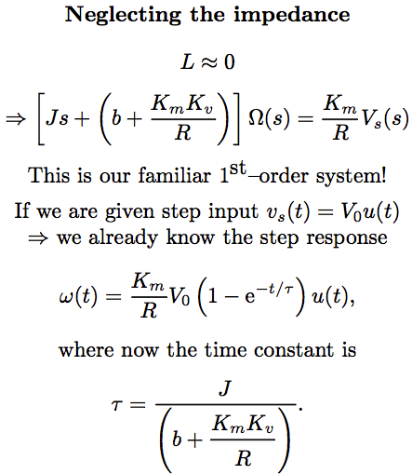

DC Motor with Mechanical Load
Neglecting the inductance (why?)
inductance
(due to windings)
dissipation
(resistance of windings)
dissipation
(viscous friction
in motor bearings)
load
(inertia)

Slide 24
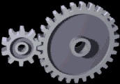
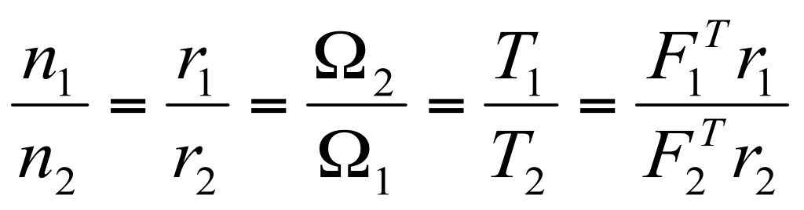






Gear Ratio and Power Conservation
Gear Ratio N:
F
Gear 1
Gear 2
Unit Conversion:
Power Conservation:

Slide 25
DC Motor with Mechanical Load
dissipation
(resistance of windings)
Neglecting the inductance…
inductance
(due to windings)
dissipation
(viscous friction
in motor bearings)
load
(inertia)

